Slide 1

CS 1103 Project Presentation
PRESENTED BY
NAME: Samridhi Girdhar
UNB ID: 3770228

Slide 2

Contents
ER diagram for university database
DDL statements for each entity & relationship
Explanation of each DDL statement in relation to ER diagram
Sample insert statements for each table.
Connect to the database using JDBC
Create database schema using JDBC
Insert records to all tables
Assuming that income tax rate is 10%, print the tax amount for each instructor about the amount of tax
Print the student with the highest grade
Write application functions (Explain the interface, Show the DML statements, Write Java Program)
Example functions (Insert/delete new students using JDBC, Insert/delete new instructor, Change a student’s department)

Slide 3
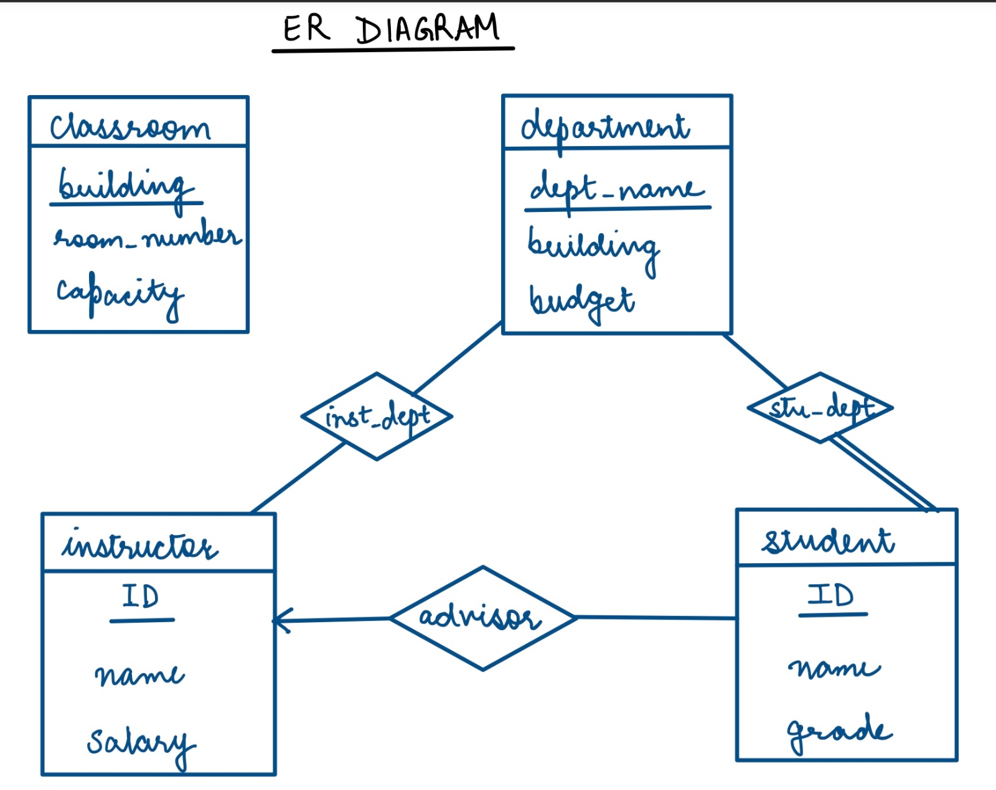
ER Diagram for University Database

Slide 4
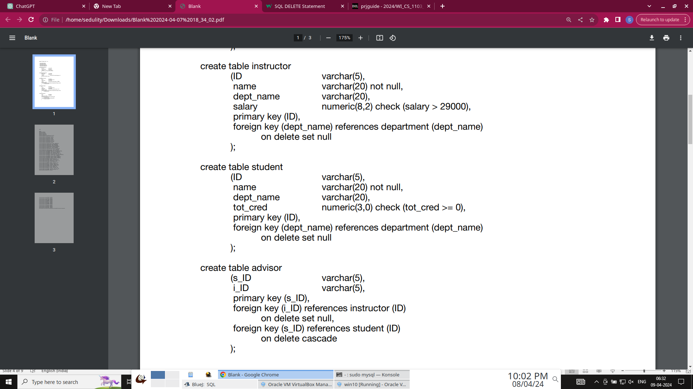
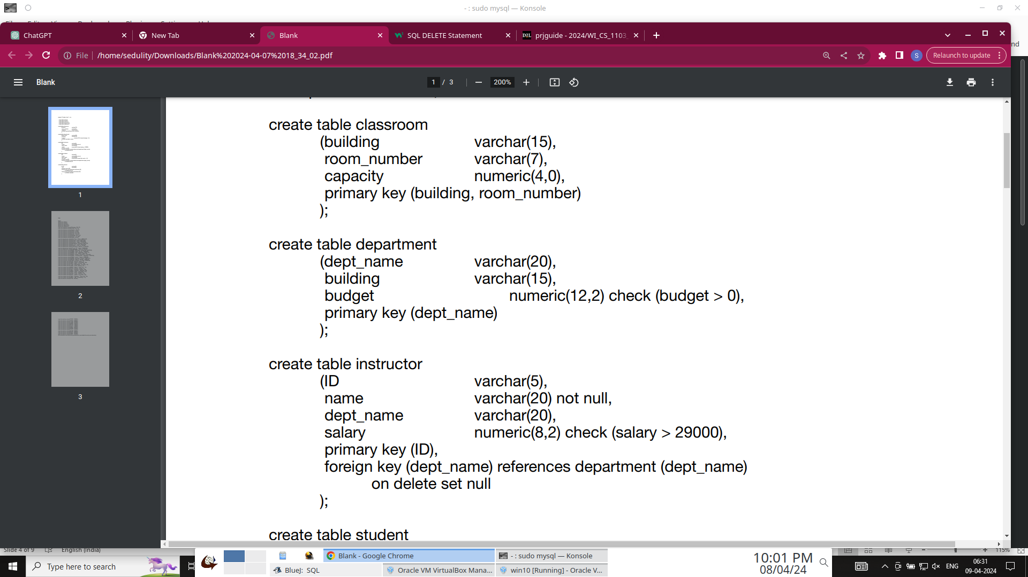
DDL Statements (for each entity & relationship)
Relationships (3)
Entities (2)
grade

Slide 5
Explanation of each DDL statement in relation to ER diagram
Classroom Table:
Attributes: building, room_number, capacity
Primary Key: building, room_number
ER Representation: A classroom is uniquely identified by its building and room number combination. It has no relationship with any other entity.
Department Table:
Attributes: dept_name, building, budget
Primary Key: dept_name
ER Representation: Each department is uniquely identified by its department name. It has relationship with instructor and student, indicated by inst_dept and stu_dept respectively inside diamonds.
Instructor Table:
Attributes: ID, name, dept_name, salary
Primary Key: ID
Foreign Key: dept_name references department(dept_name)
ER Representation: Each instructor is uniquely identified by their ID. In the rectangle of this table, dept_name is not mentioned as it is foreign key. It has partial relationship (inst_dept) w.r.t dept_name with table department.
Student Table:
Attributes: ID, name, dept_name, grade
Primary Key: ID
Foreign Key: dept_name references department(dept_name)
ER Representation: Each student is uniquely identified by their ID. In the rectangle of this table, dept_name is not mentioned as it is foreign key. It has total relationship (stu_dept) w.r.t dept_name with table department.
Advisor Table:
Attributes: s_ID, i_ID
Foreign Key: i_ID references instructor(ID), s_ID references student(ID)
ER Representation: The advisor table represents the relationship between instructors and students. There's a one-to-many relationship between instructors and students indicated by arrow, where one instructor can advise many students, but each student has only one advisor.

Slide 6
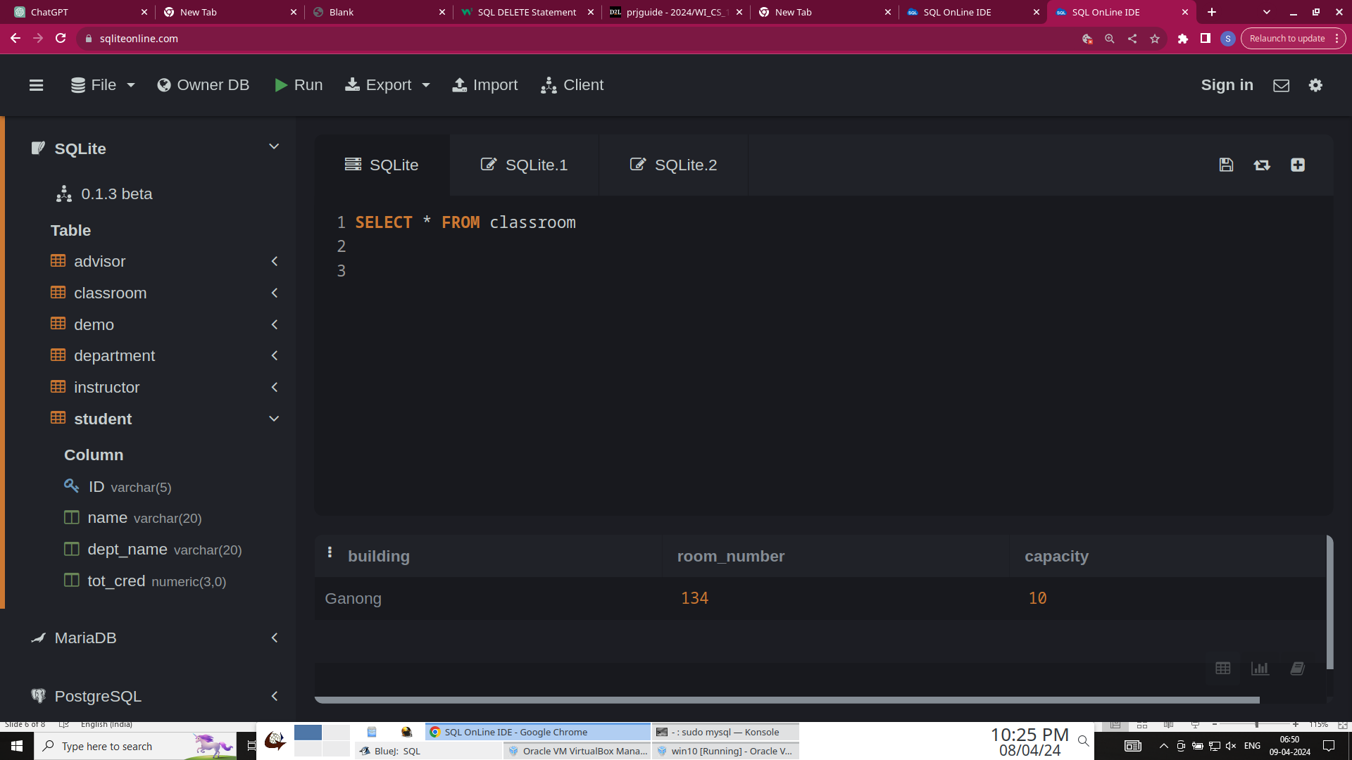
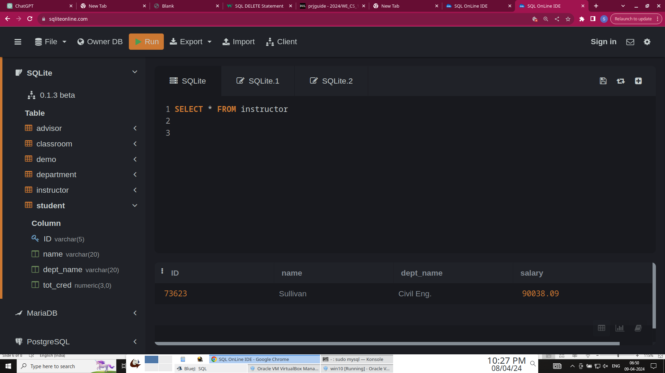
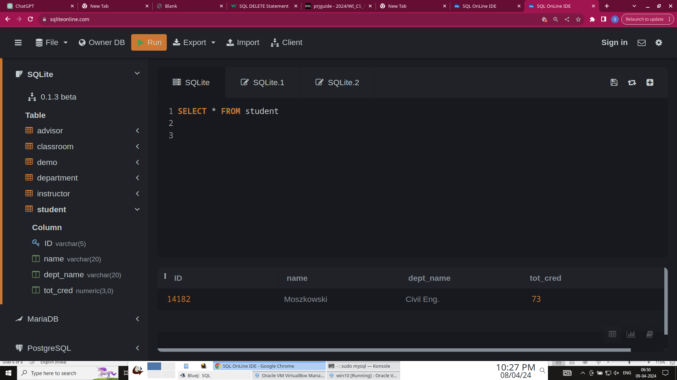


Sample insert statements for each table
Here, only 1 sample insert statement for each table is shown (All records are shown below using JDBC). Output of these commands is also shown using screenshots taken from SqlLite implementation.
insert into classroom values('Ganong', 134, 10);
insert into department values('Civil Eng.', 'Hazen', 255041.46);
insert into instructor values('73623', 'Sullivan', 'Civil Eng.', 90038.09);
insert into student values('14182', 'Moszkowski', 'Civil Eng.', 73);
insert into advisor values('14182', ‘73623');
grade

Slide 7
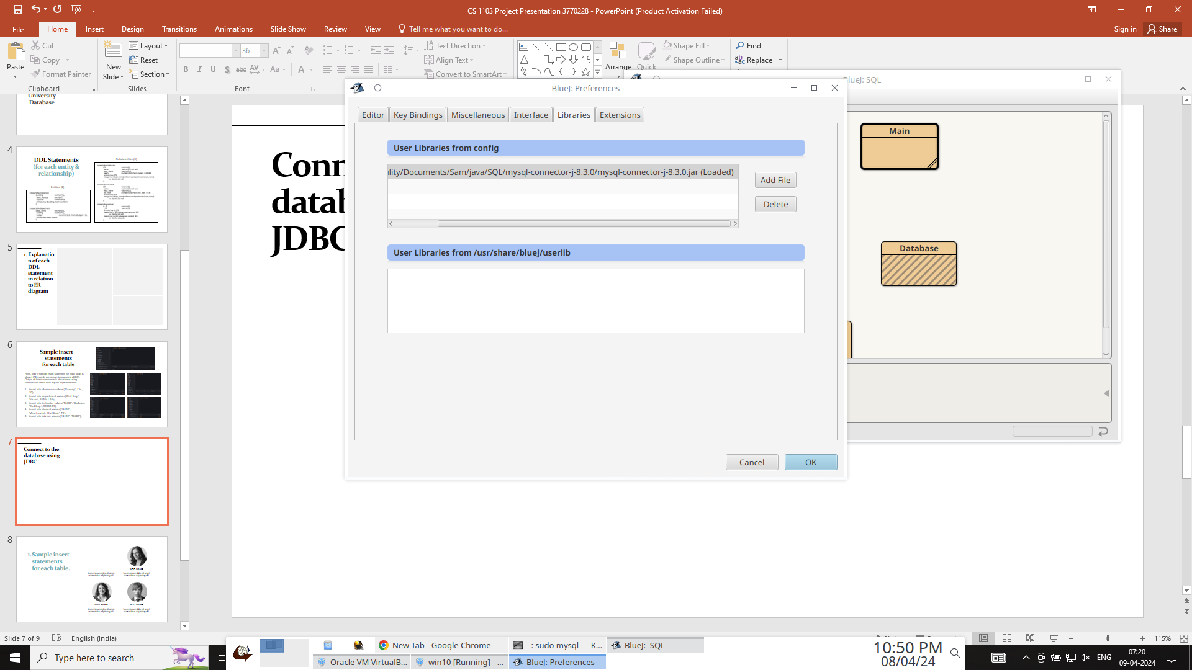
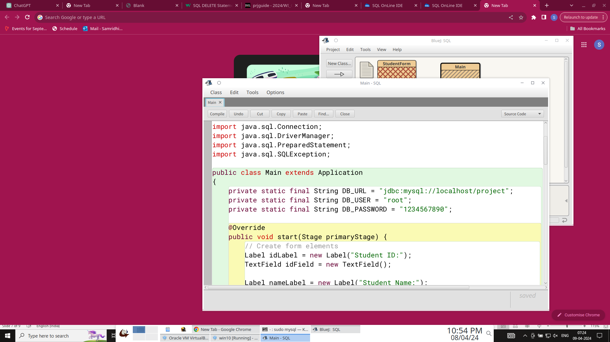
Connect to the database using JDBC
I created a database named Project in my machine using command-line. I downloaded .jar driver from Oracle’s website and imported it in BlueJ library.
Now using JDBC API package java.sql, I connect my java program to my database.

Slide 8
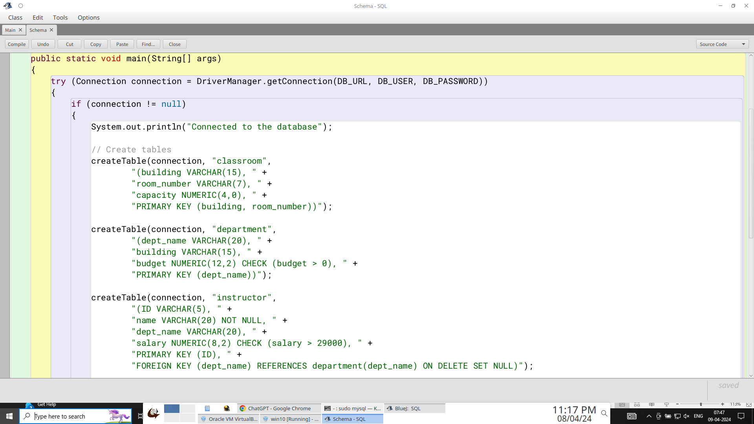
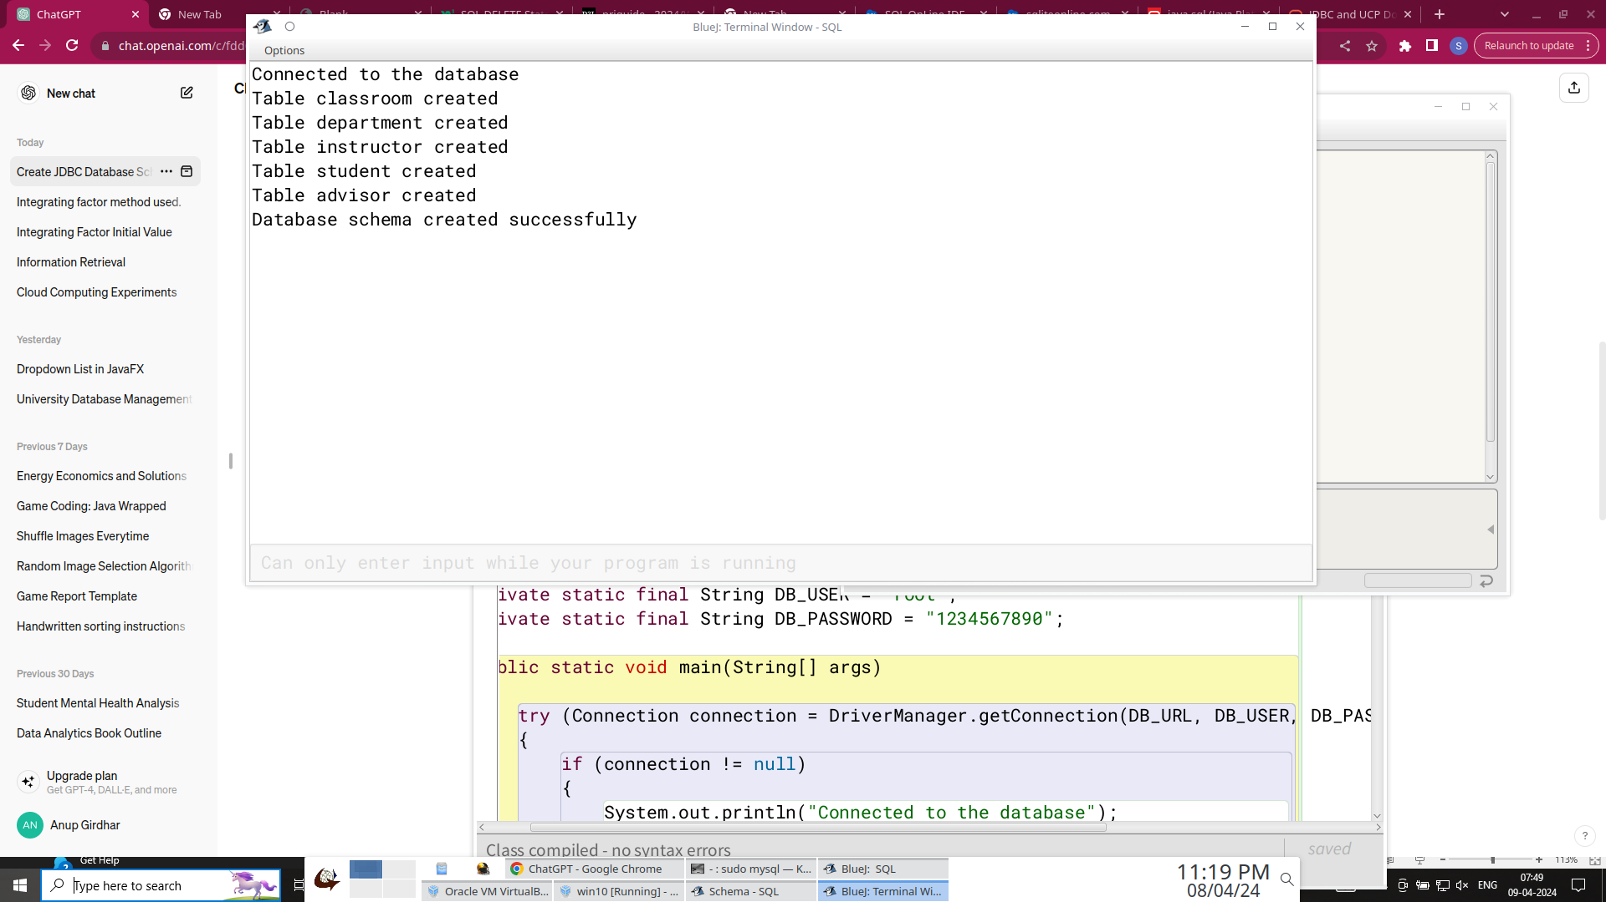
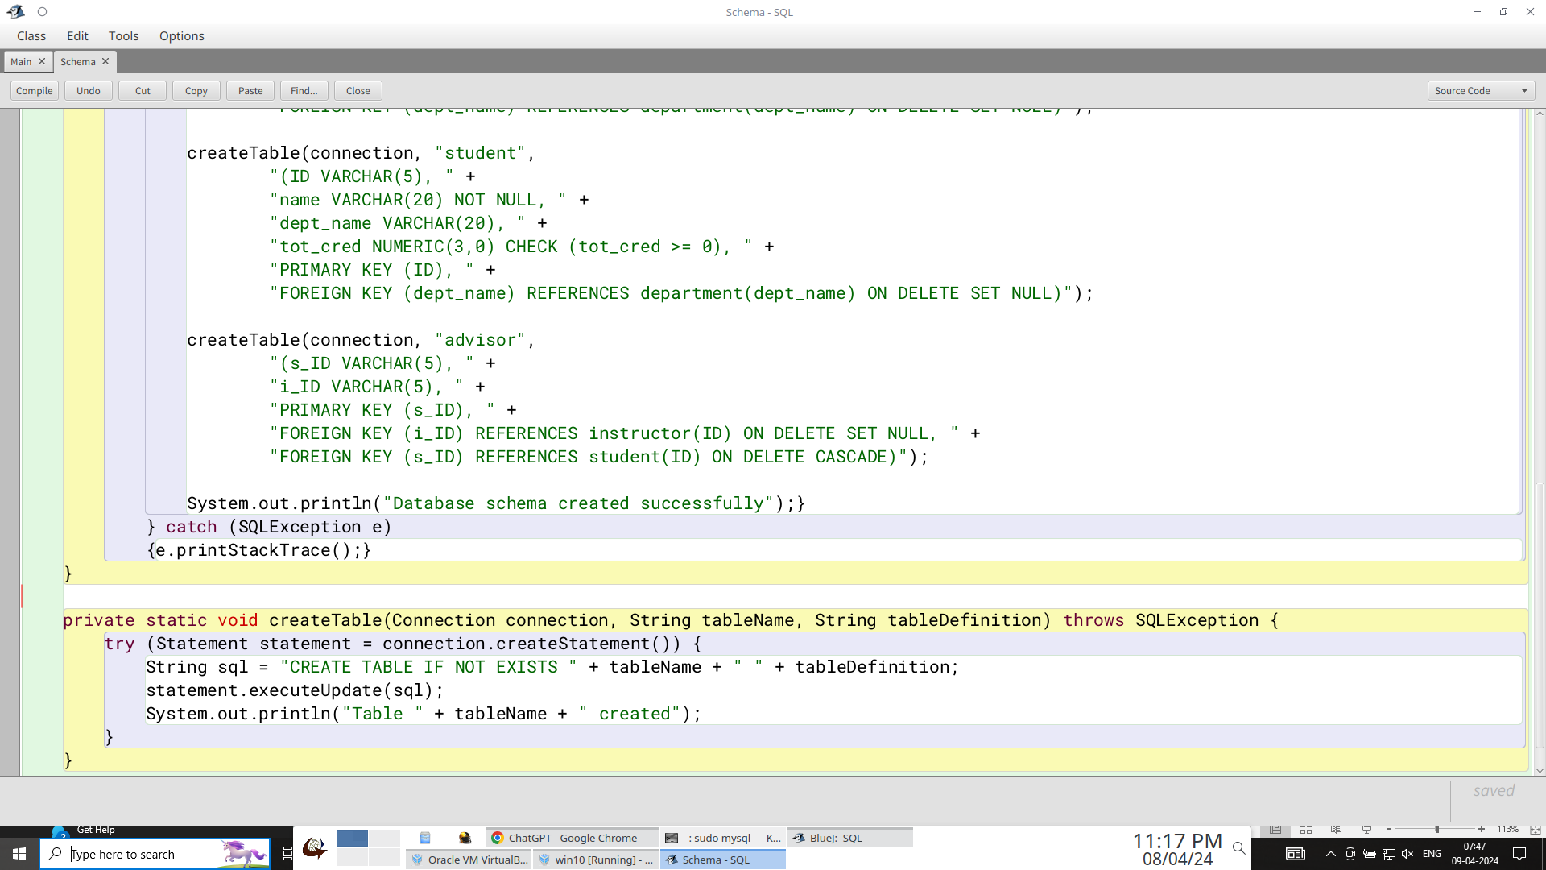
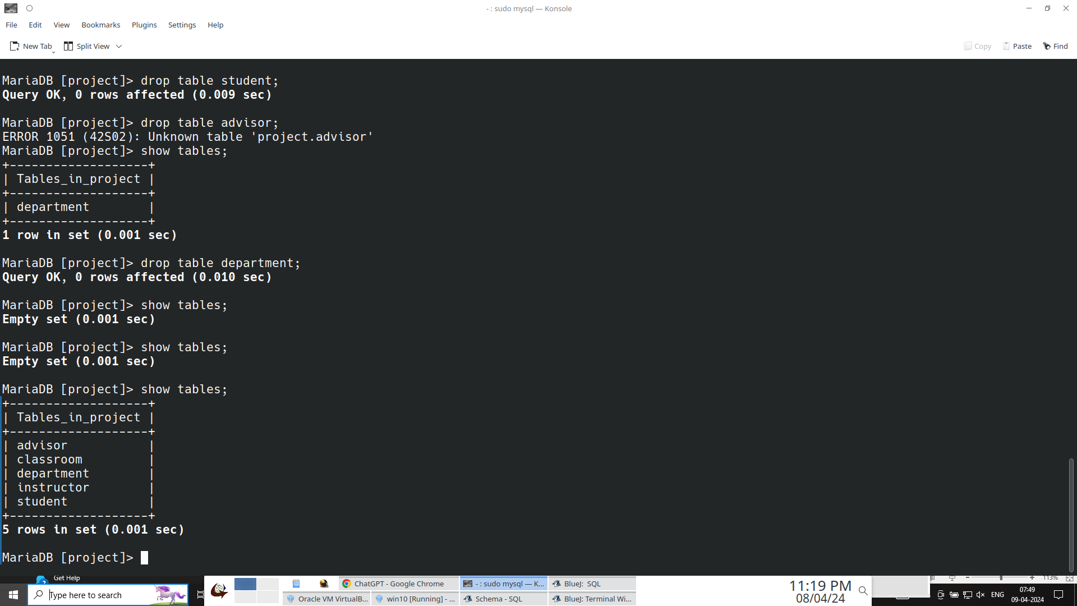
Create database schema using JDBC
Java Code to create schema
BlueJ output to show all tables are created
Command-line output before running the code
grade
Tables created in my database

Slide 9
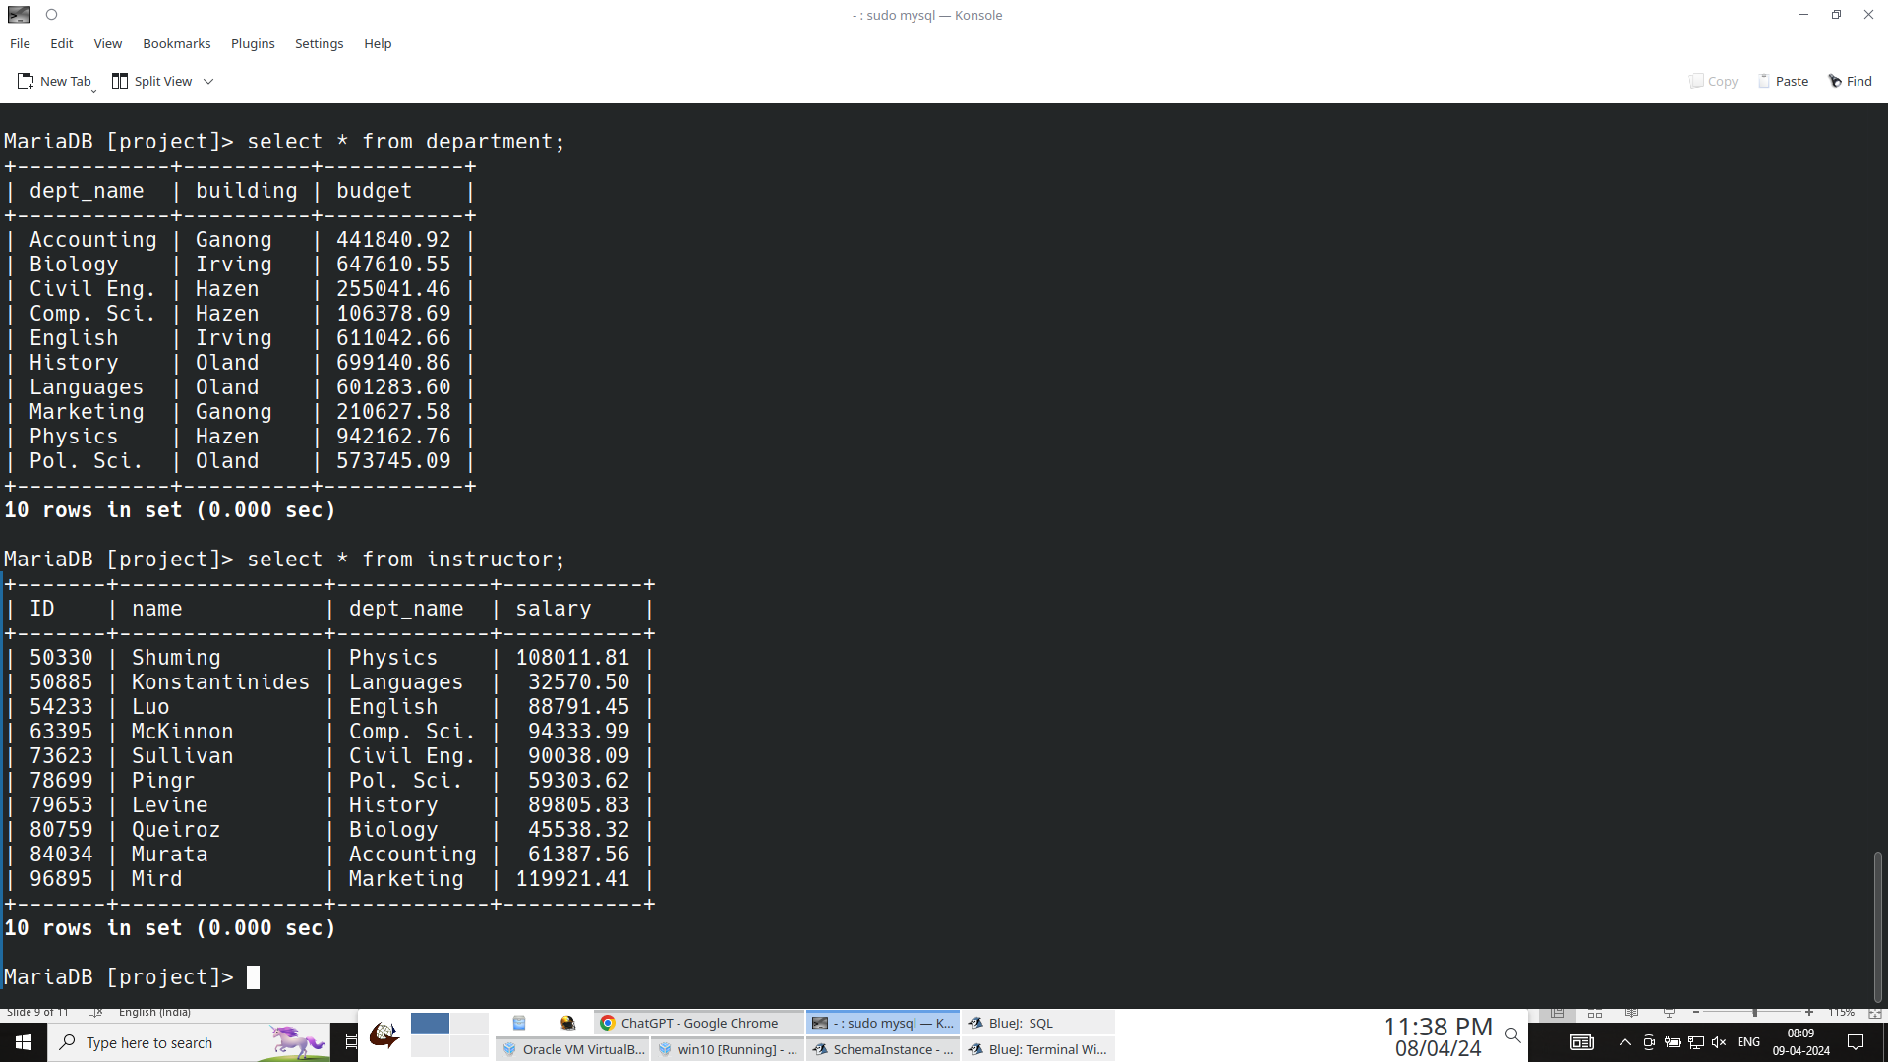
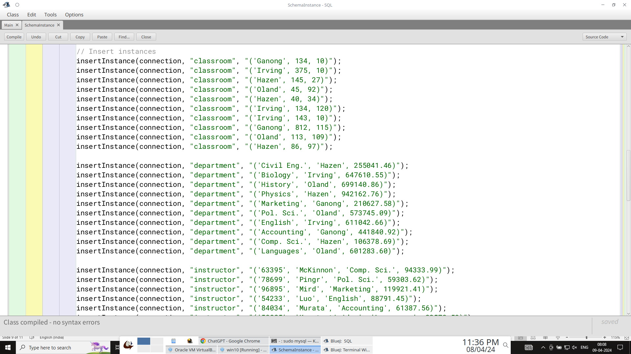
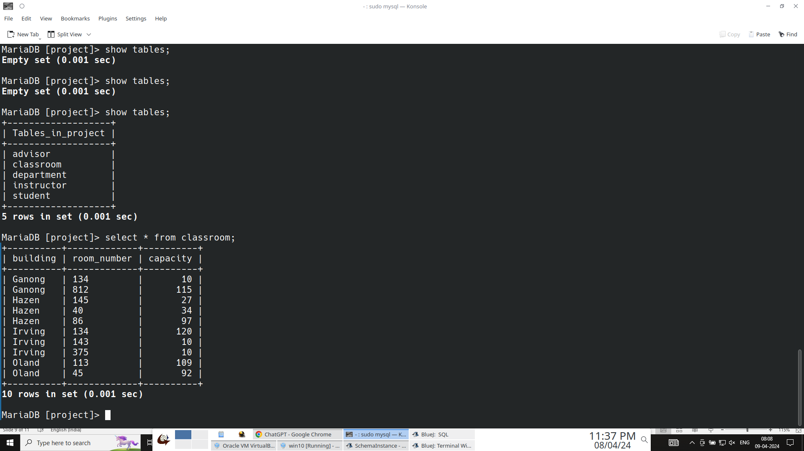
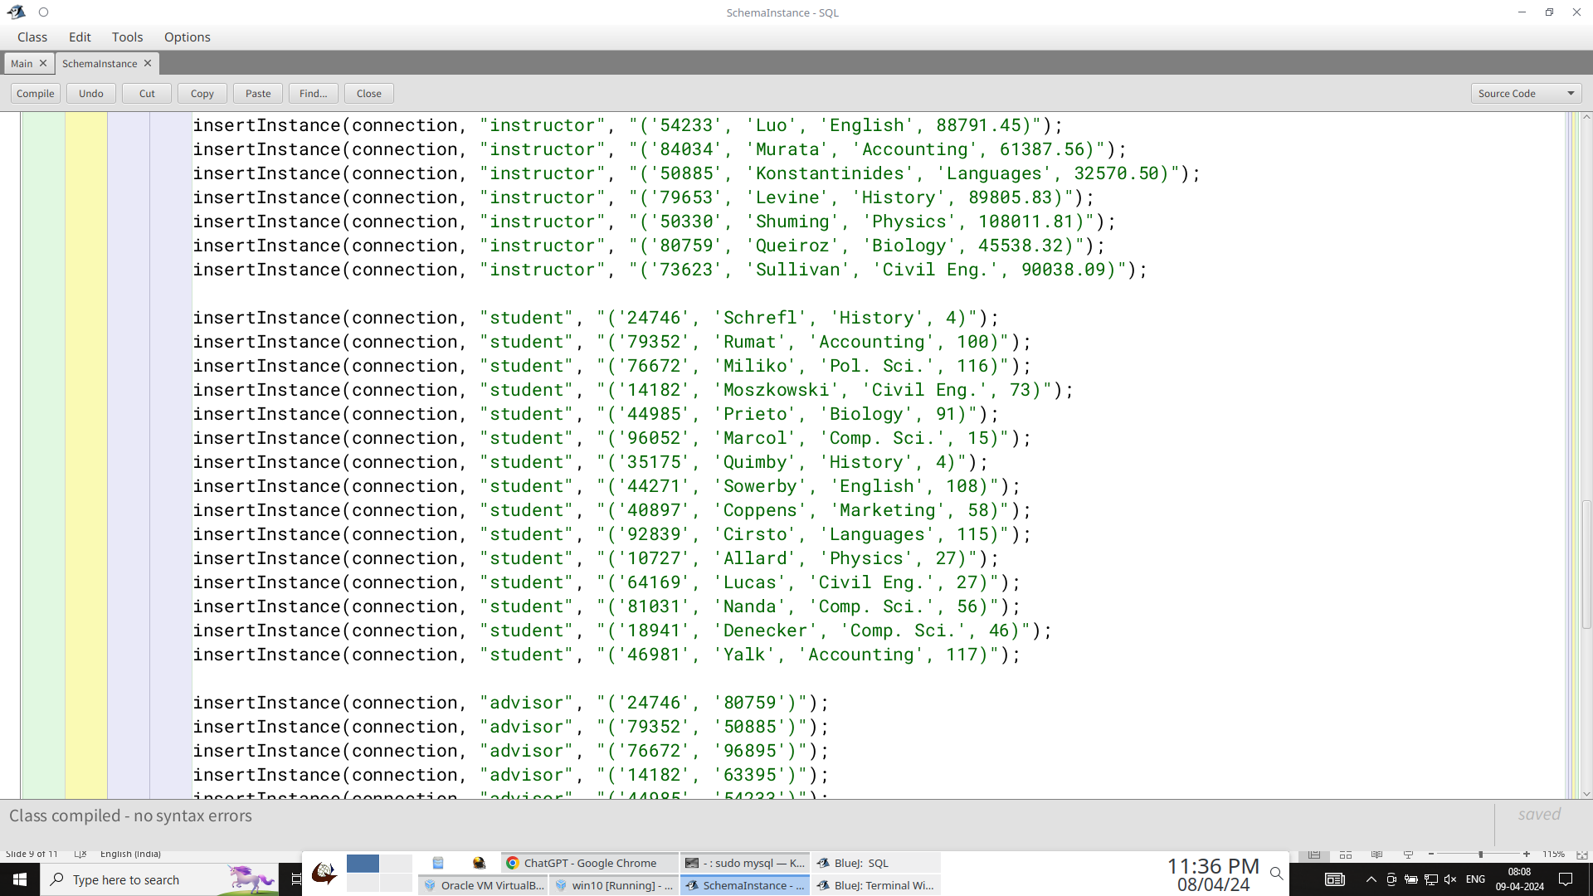
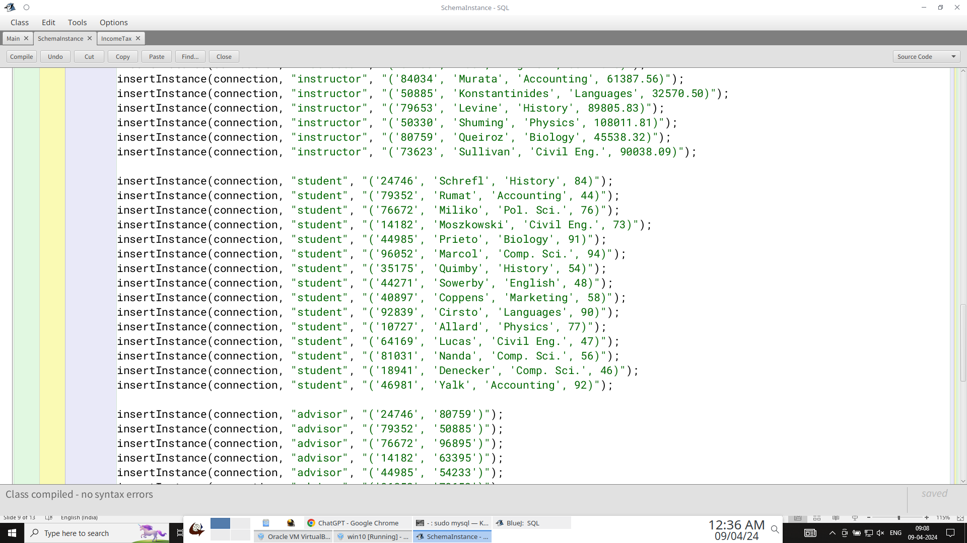
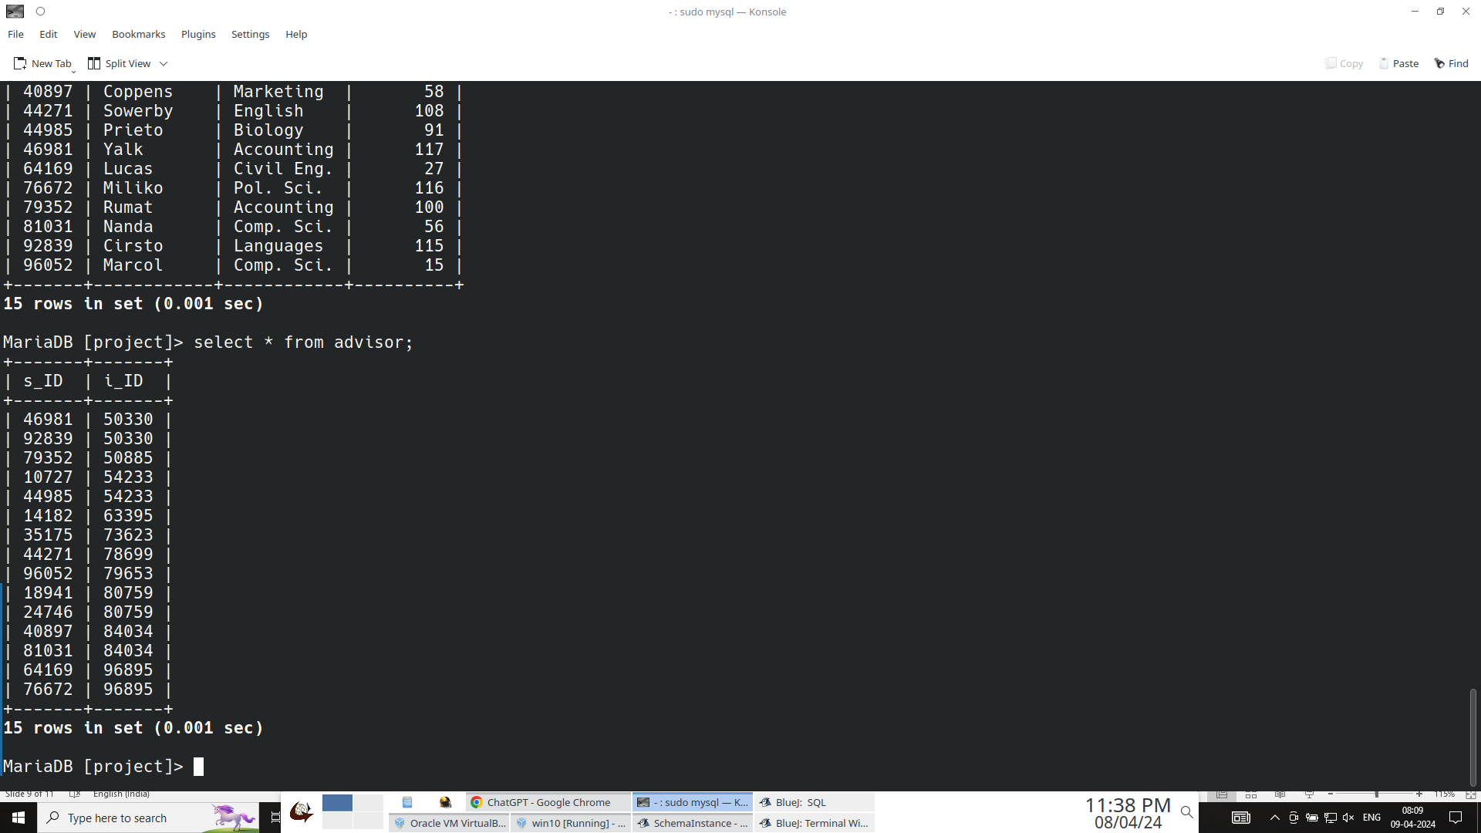
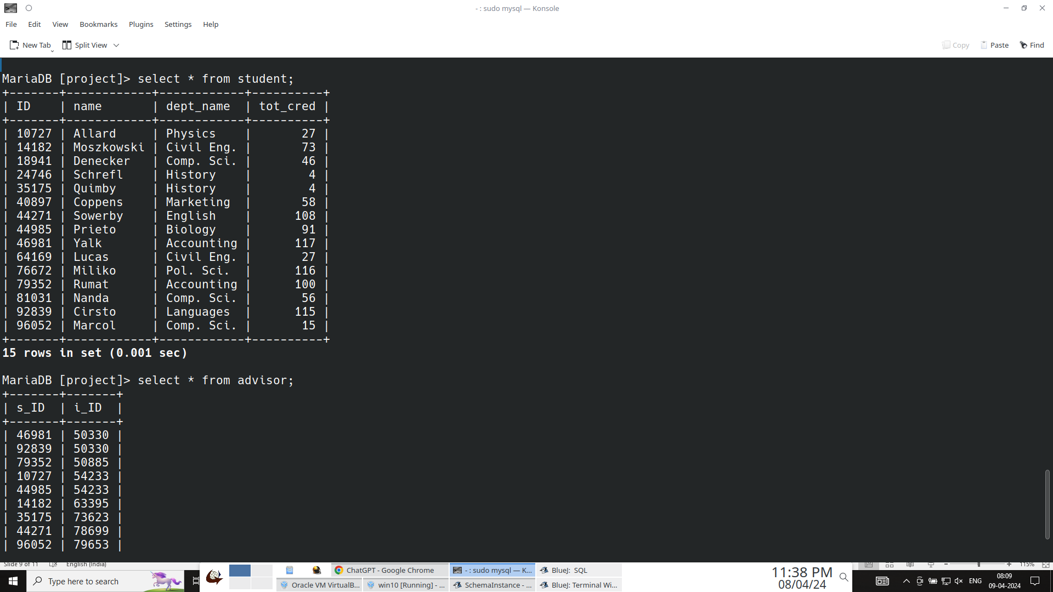
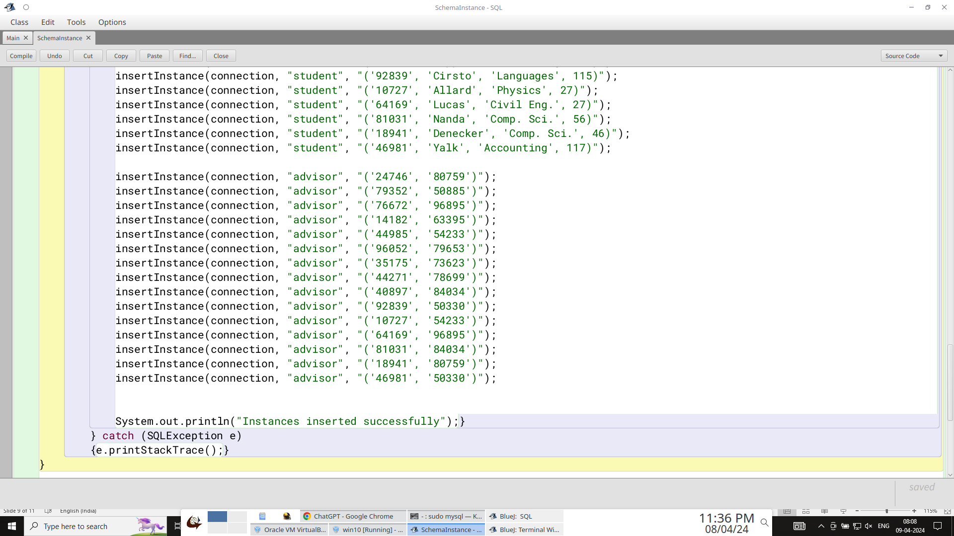
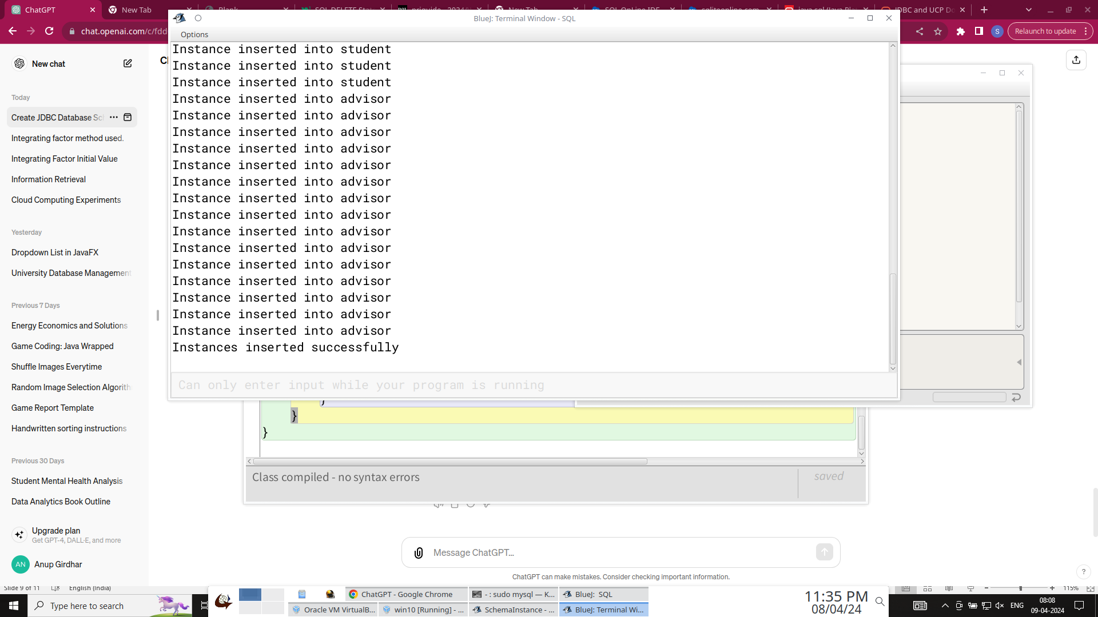
Insert records to all tables
Command-line output of records being added to the tables in my database
grade
Java Code and BlueJ output (last 2 lines)

Slide 10
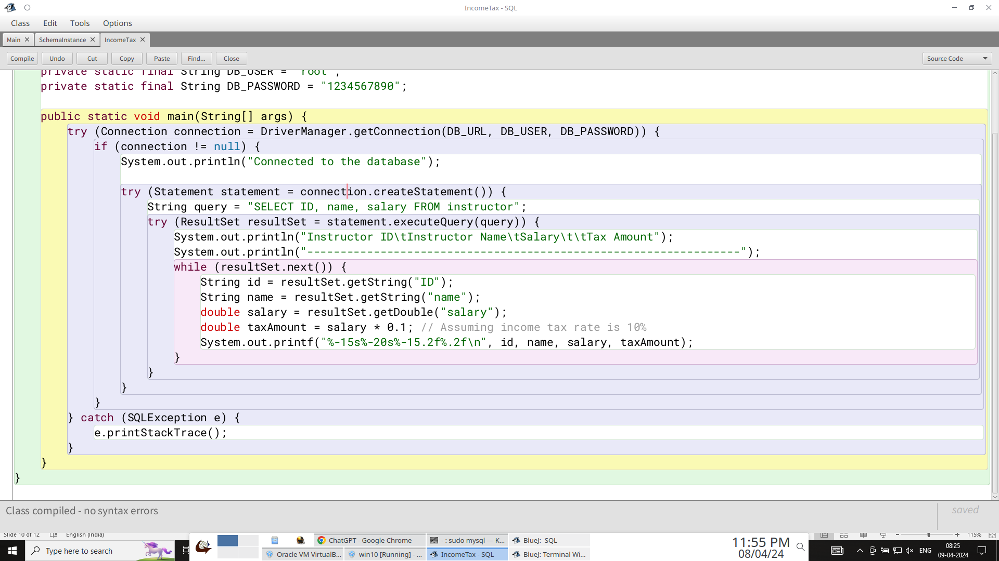
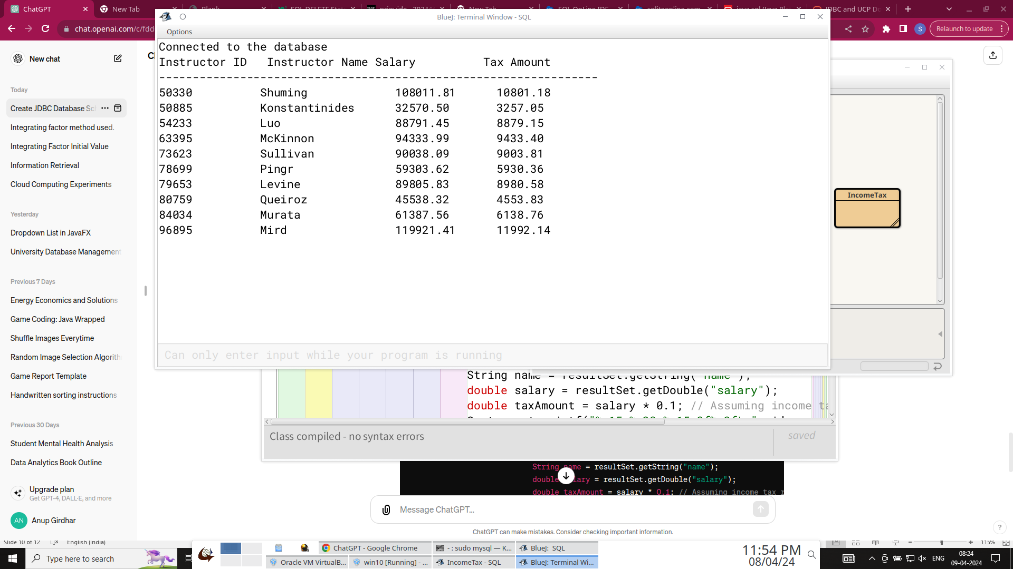
Assuming that income tax rate is 10%, print the tax amount for each instructor about the amount of tax
Java Code to print 10% Income Tax
BlueJ output with printed tax amount

Slide 11
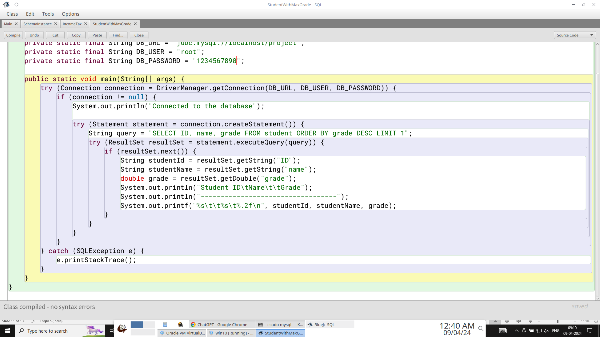
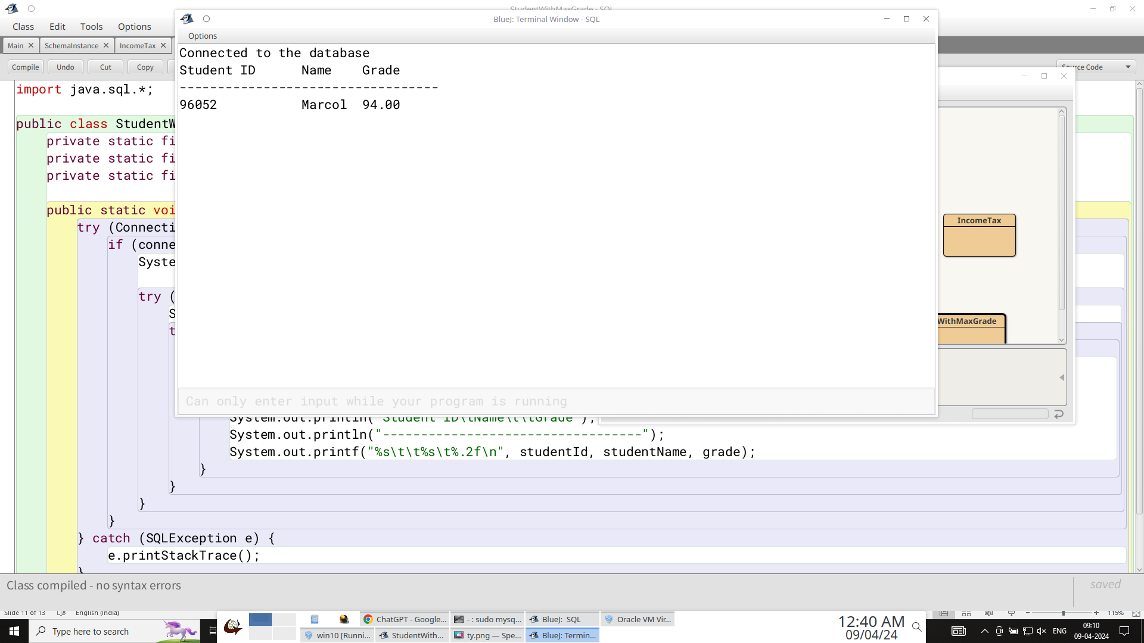
Print the student with the highest grade
BlueJ output with printed student who has the highest grade
Java Code to print student with highest grade

Slide 12
Write application functions (Explain the aaplication, Show the DML statements)
I made a JavaFX application which performs functions like insertion, deletion of students and instructors, and change of student’s department. I utilized JDBC API package java.sql to connect to my existing database. I used javaFX options like labels and lists to take the input for mentioned functions. I connected the input to database output using buttons. Screenshots for complete java code of my application is added in further slides along with input in javaFX and output in my database.
The DML Statements for insertion, deletion and update are mentioned follows:
Insert a student: insert into student values(‘00001’, ‘Sam’, ‘Comp. Sci.’, 90);
Delete a student: delete from student where ID=‘00001’;
Insert an instructor: insert into instructor values(‘00001’, ‘Sam’, ‘Comp. Sci.’, NULL); {in application, I did not include salary to show that databases have no empty element, NULL is filled itself}
Delete an instructor: delete from instructor where ID=‘00001’;
Change a student’s department: (1) update student set dept_name = ‘History‘ where ID = '10727';
(2) Update student set dept_name = ‘Physics’ where ID = ‘10727’;

Slide 13
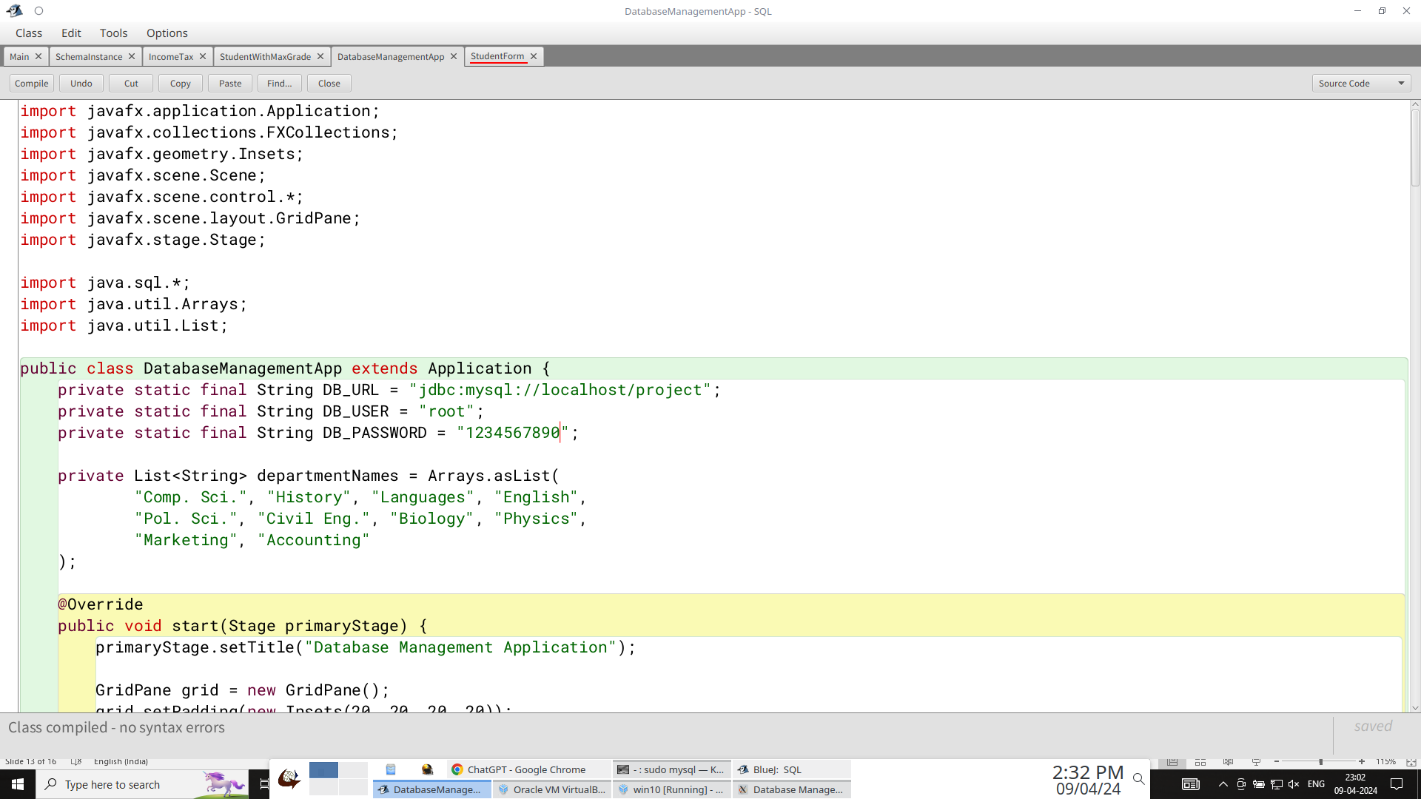
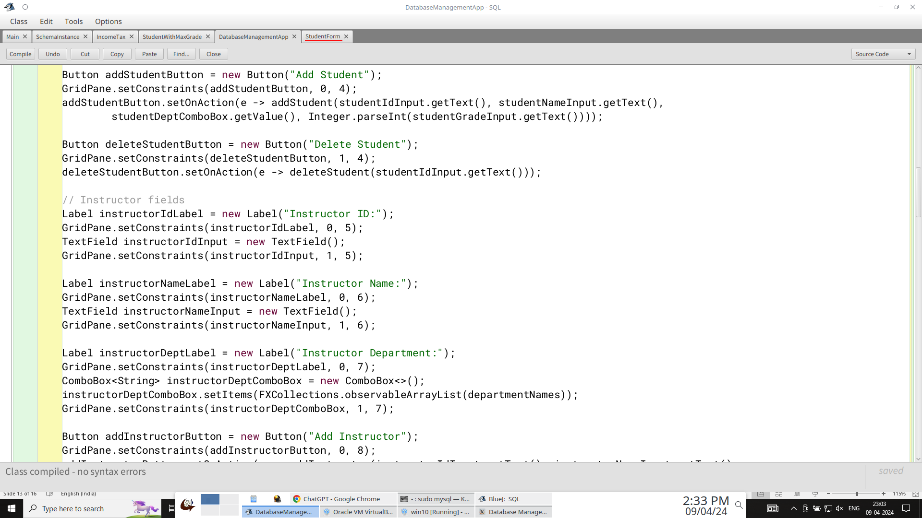
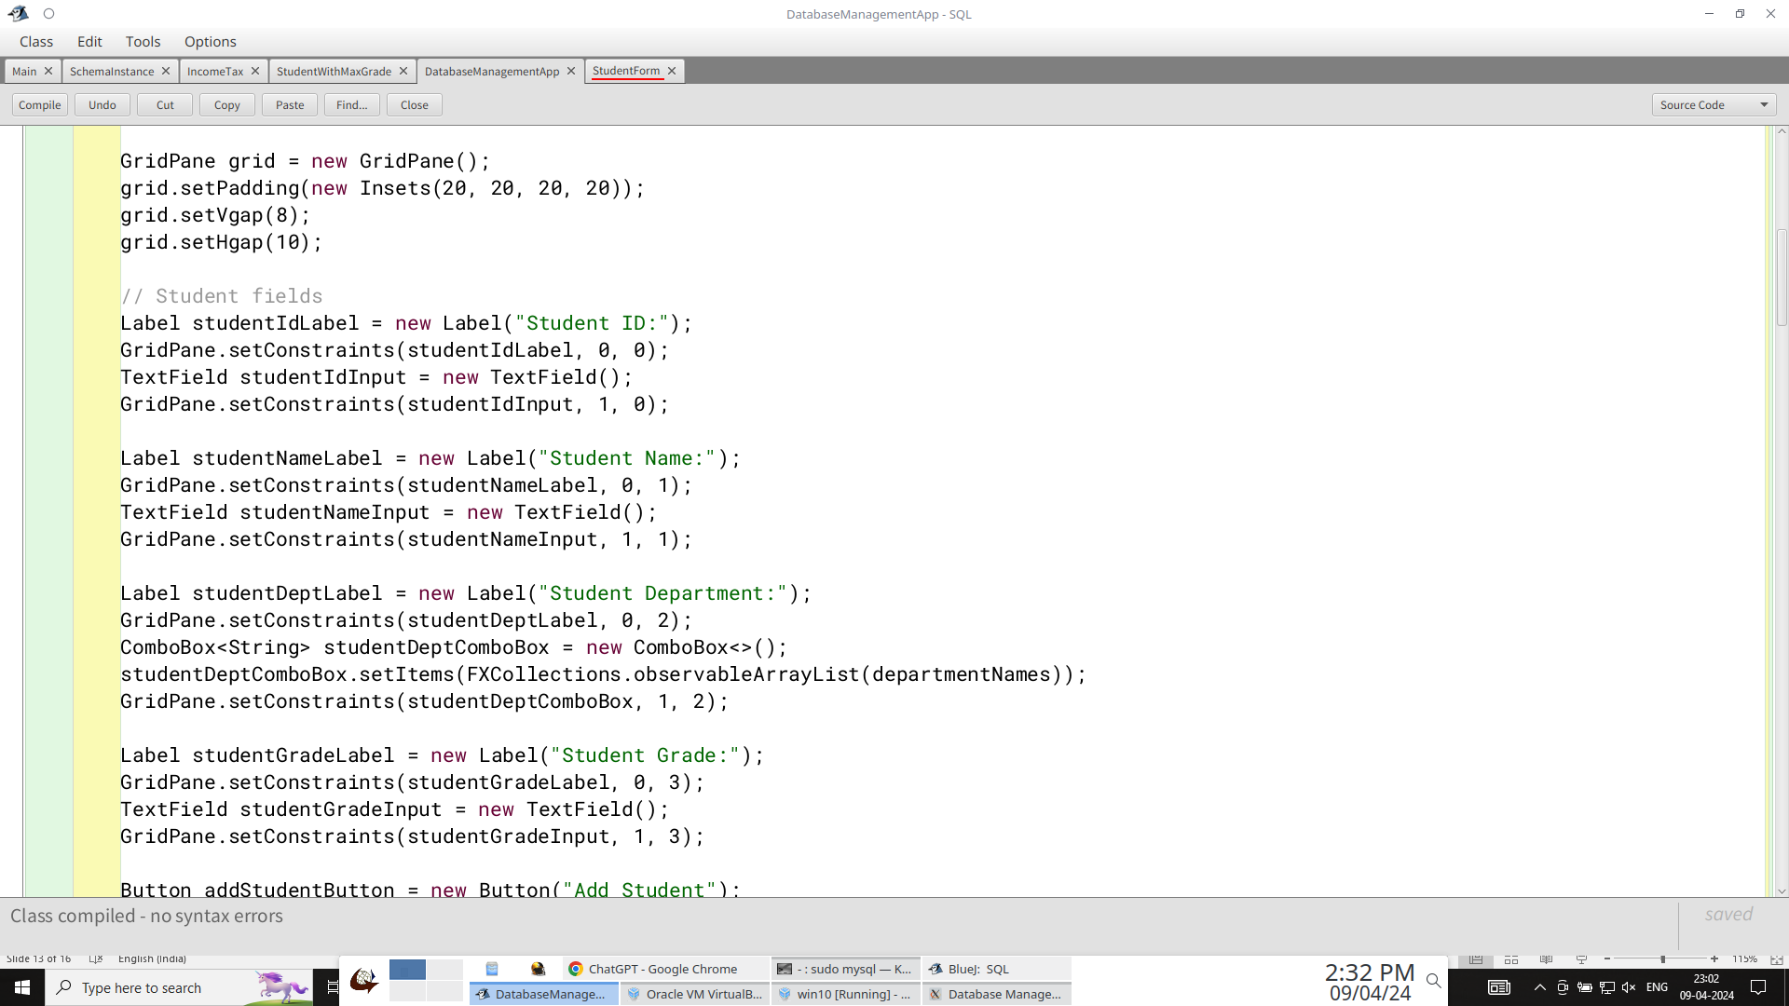
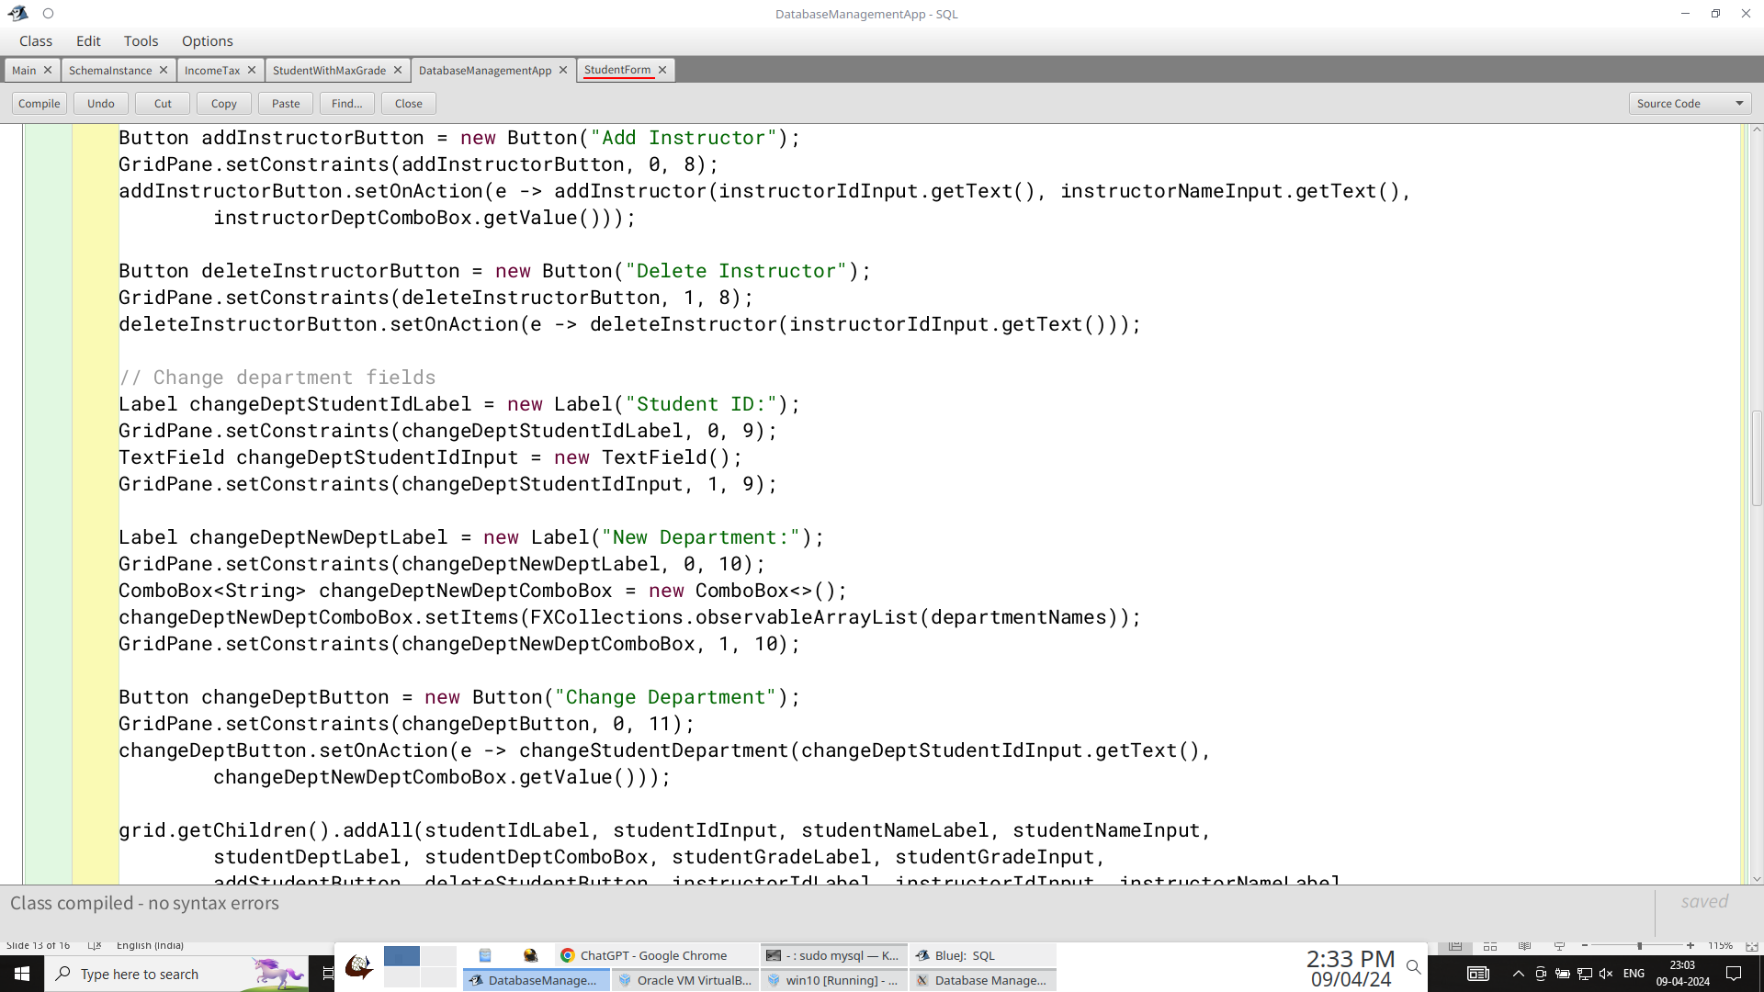
Java Program for Application
2
1

Slide 14
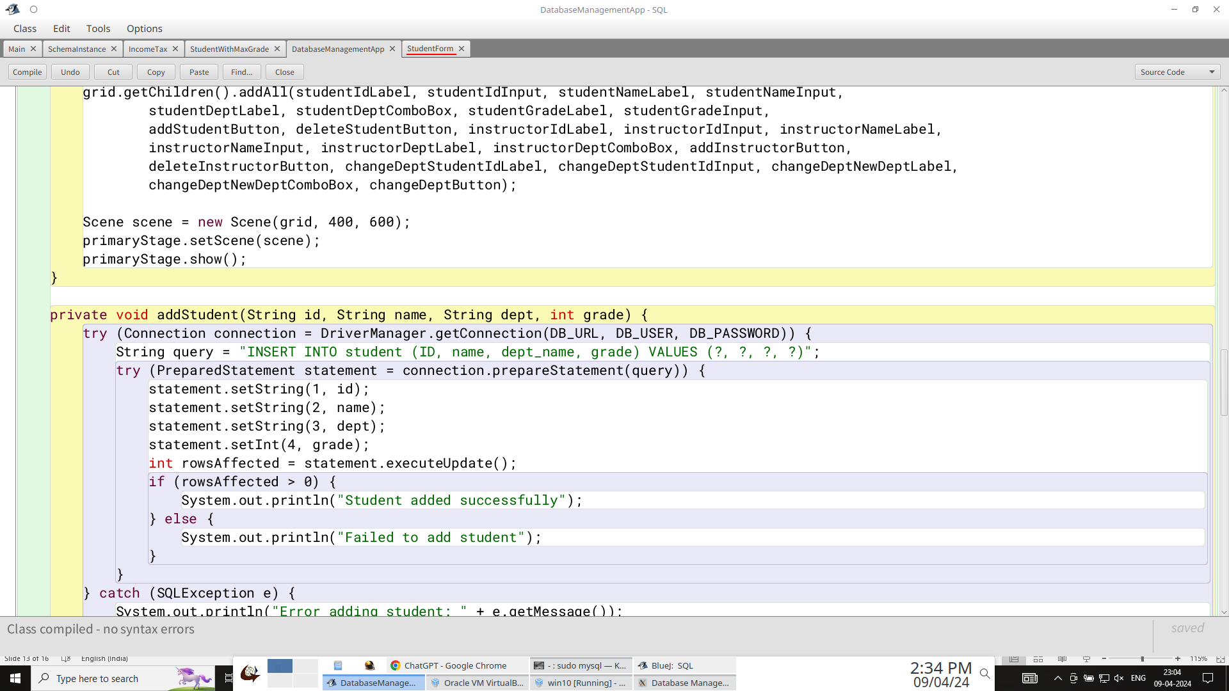
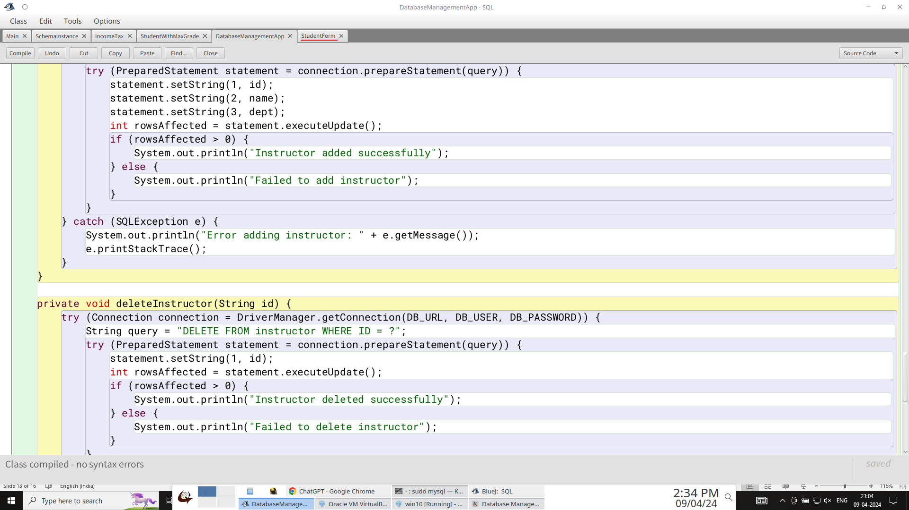
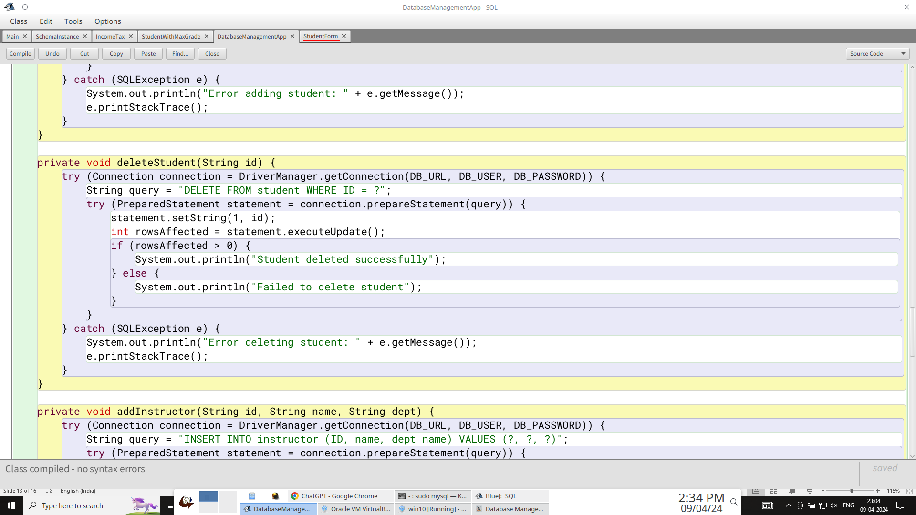
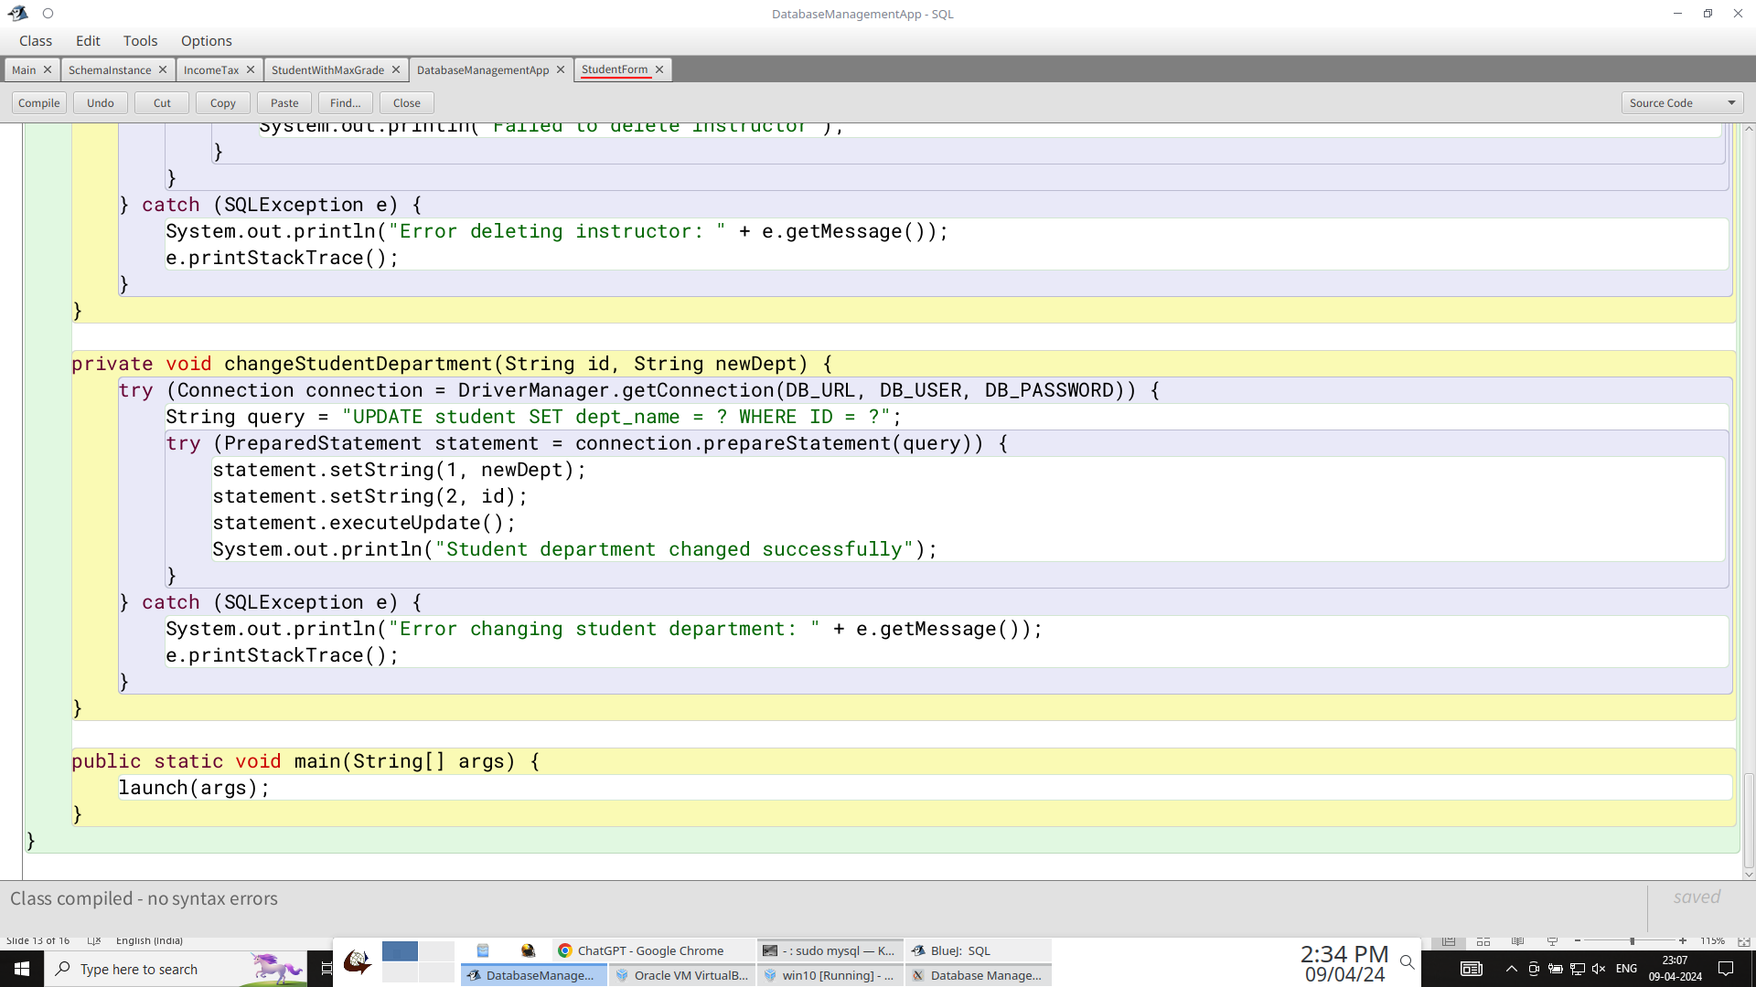
4
3

Slide 15
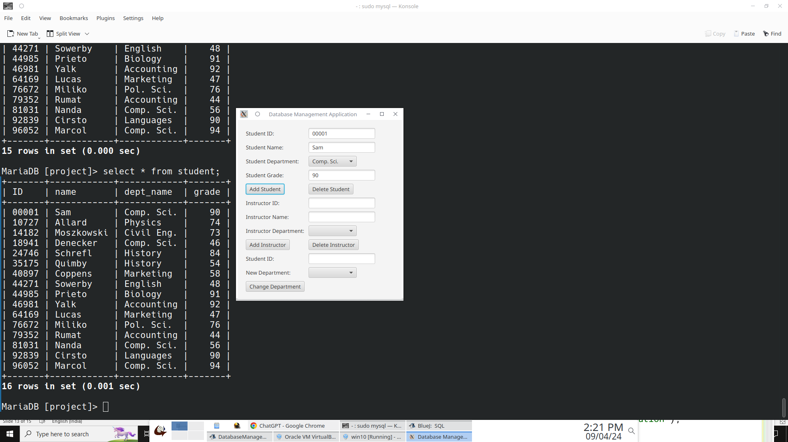
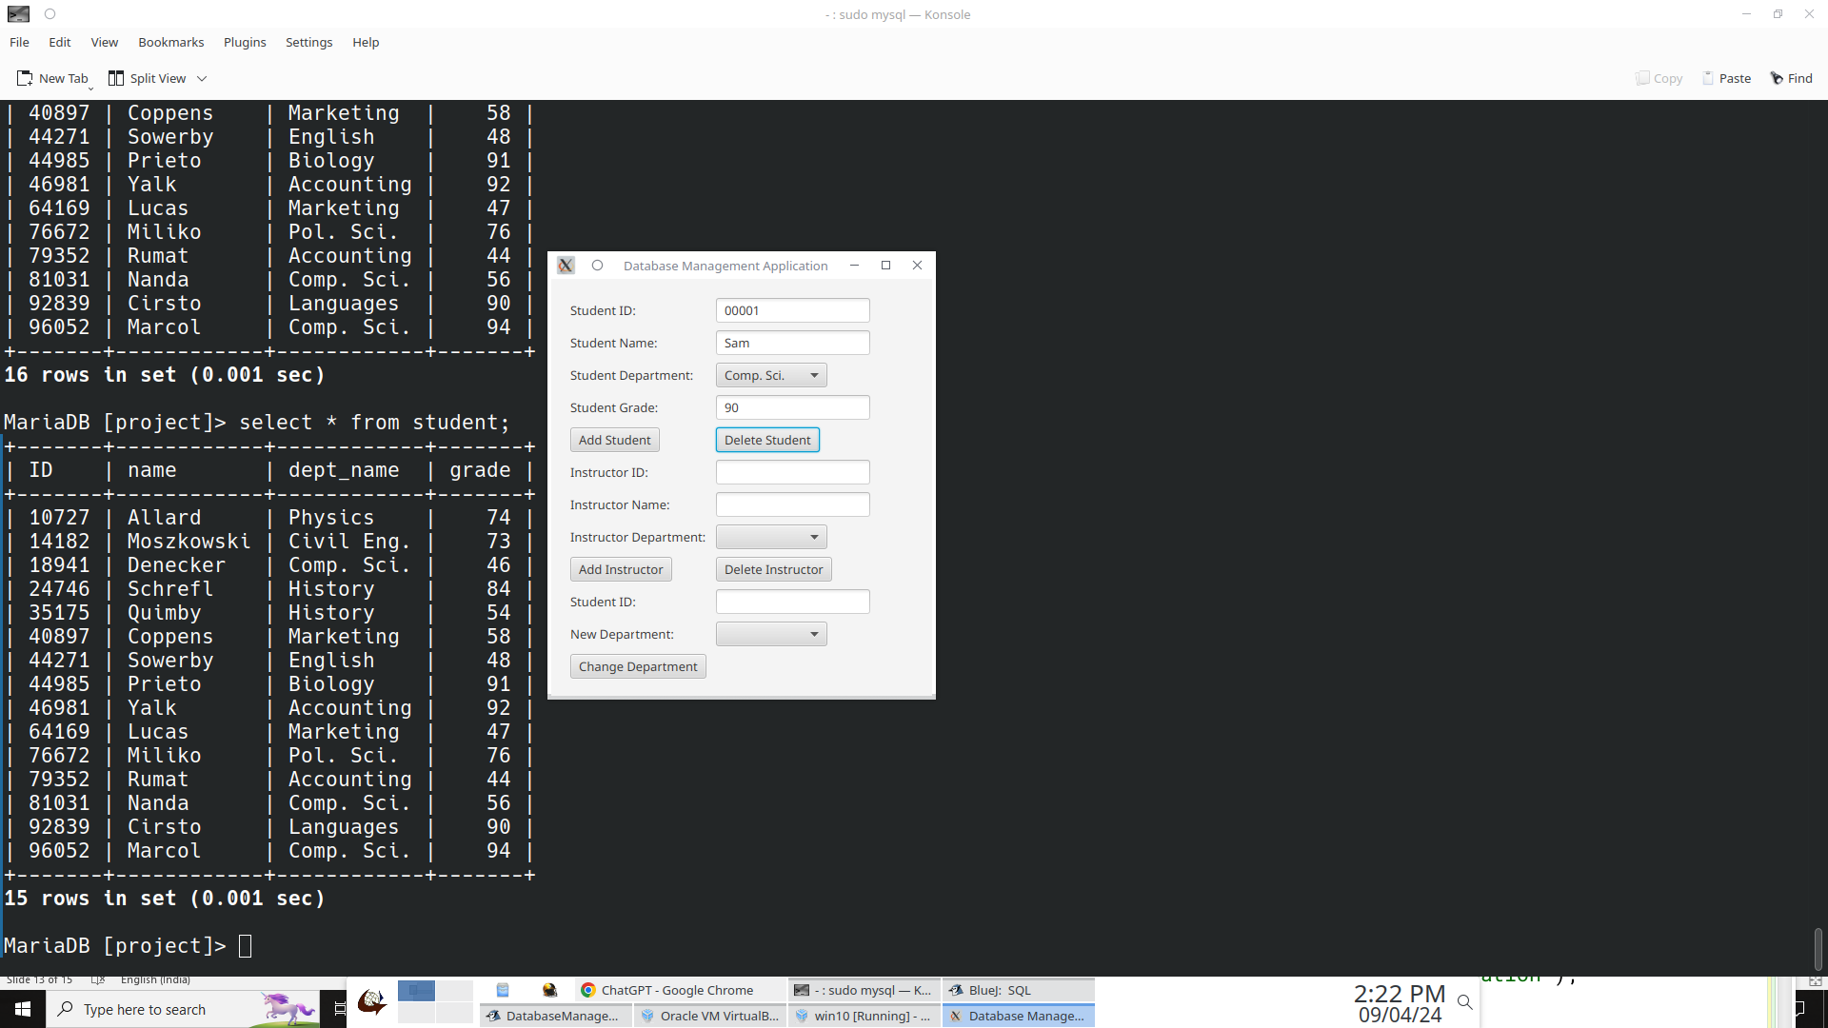
Example functions (Insert/delete new students using JDBC)

Slide 16
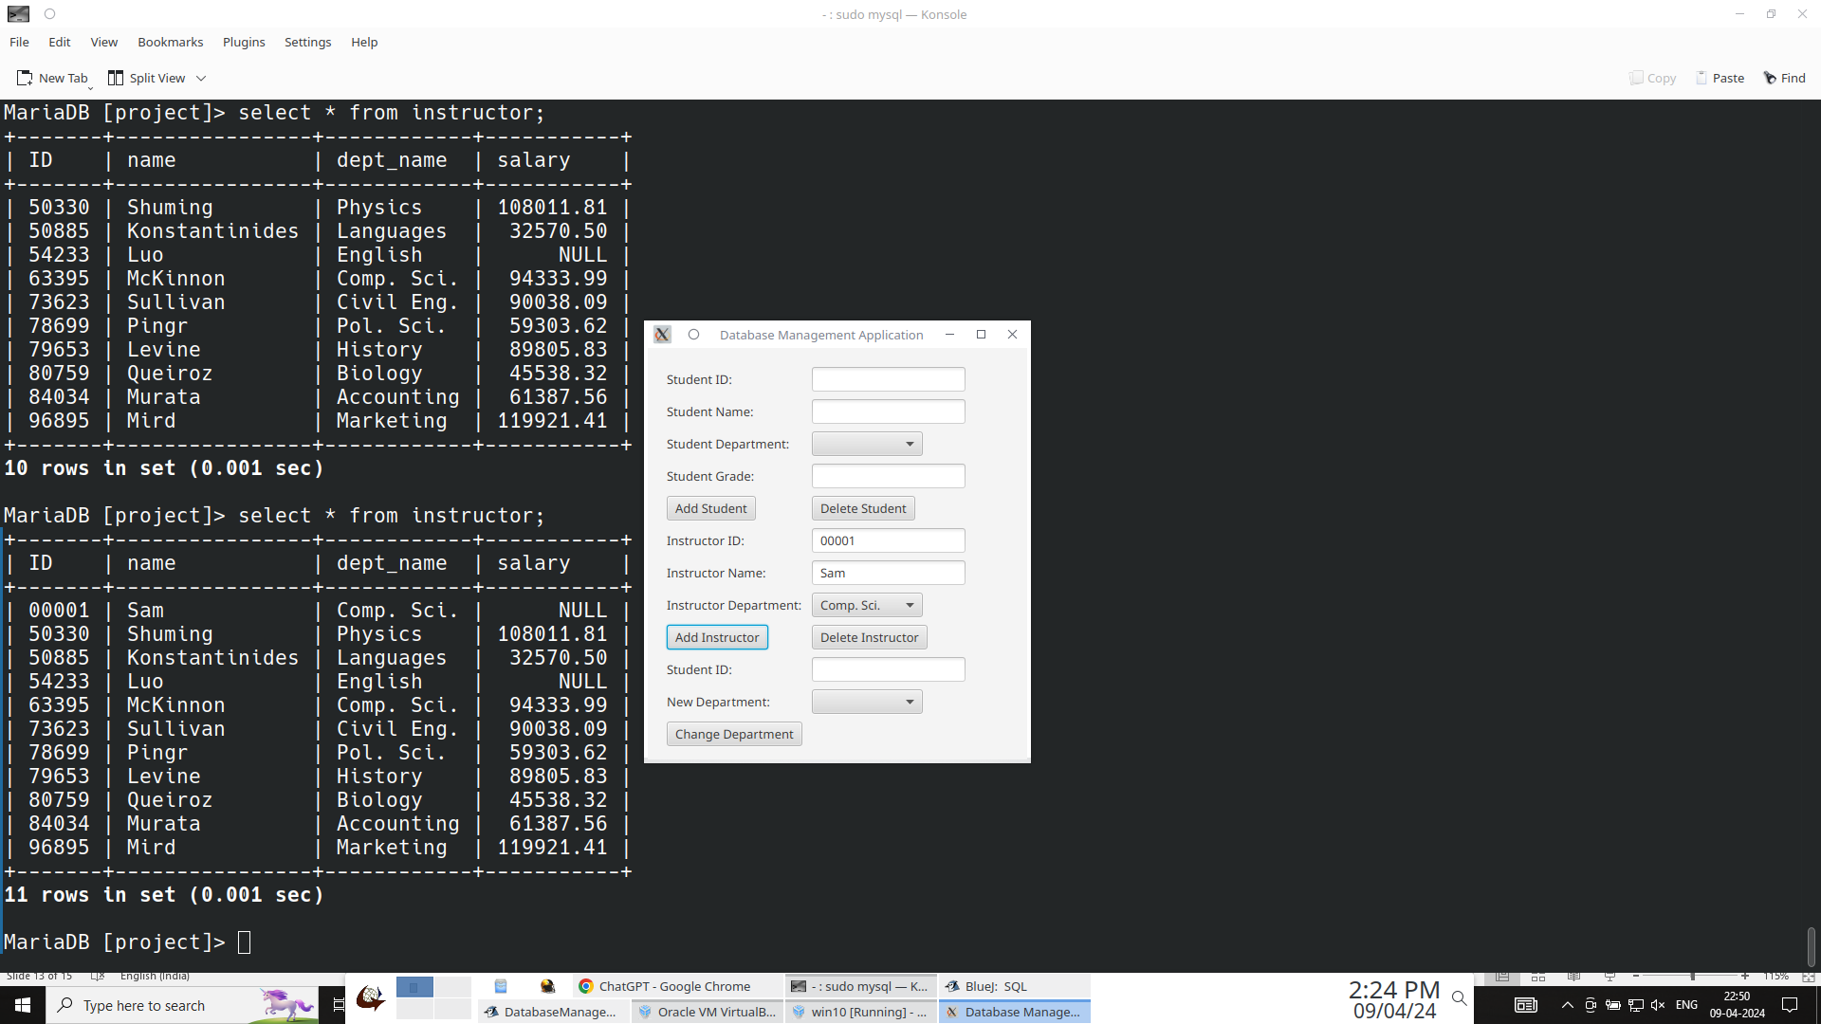
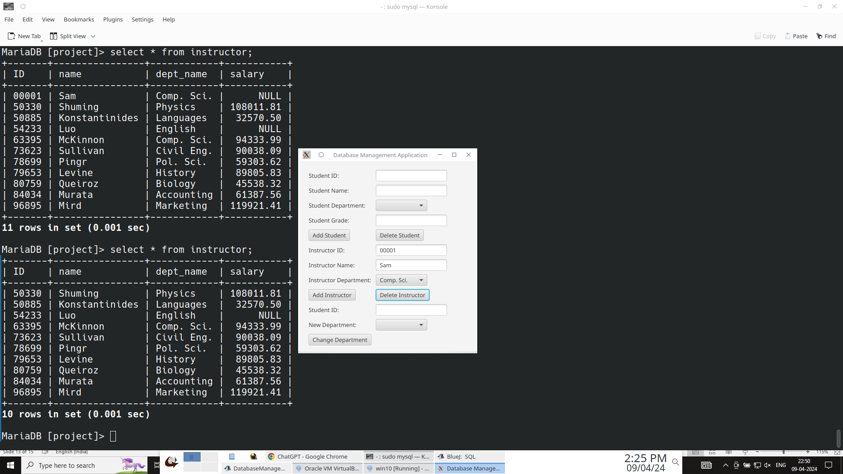
Example functions (Insert/delete new instructor)

Slide 17
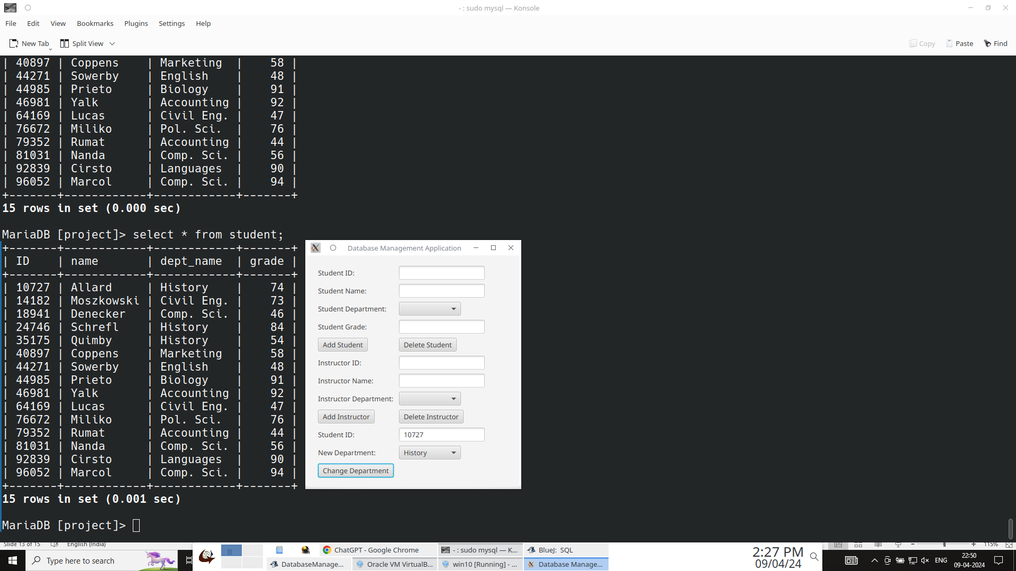

Example functions (Change a student’s department)

